Slide 1
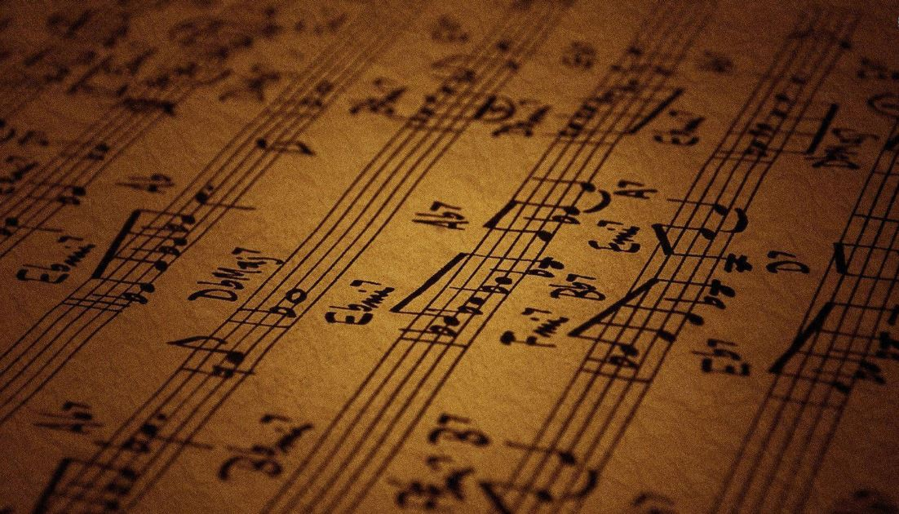
MEDLAI Mood-Based Music Composition Using AI
Research Project
Supervised By:
Dr. Mubasher Baig

Slide 2
Team Members
Abdullah Khan
15L-4322
Ahmad Zaheer
15L-4018
Aqsa Zia
15L-4118
Talha Saqib
15L-4172
Notes:
-4018

Slide 3
Project Introduction
Notes:
-4018

Slide 4
Problem Statement
“To automate the music composition process using artificial intelligence in such a way that music is generated based on a certain mood provided by the user. The mood could be sad, happy, exuberant mellow and as such.”
Notes:
-4018

Slide 5
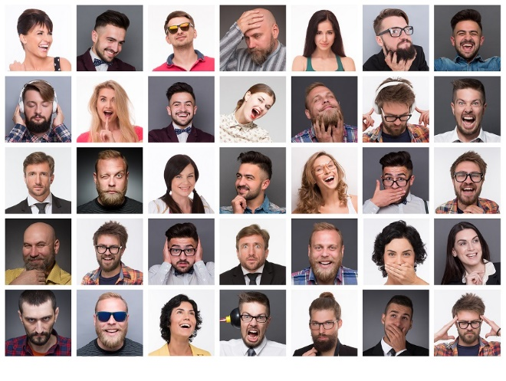


Project Goals
To generate music based on mood/emotions

Slide 6
Project Goals (Cont’d)
Generate music on the basis of at least 2 moods
Maintain the mood of music
Pleasant music
The methodology should either improve existing approaches or be completely different.

Slide 7

Project Goals (Cont’d)
To output the generated music transcription in the traditional musical language.
Polyphonic music
Music from Music
Playable audio files
Conclude our findings on which model/algorithm is good for composing mood-based music

Slide 8

Previous Results (RNN)
Sad
Happy

Slide 9

Implementation

Slide 10
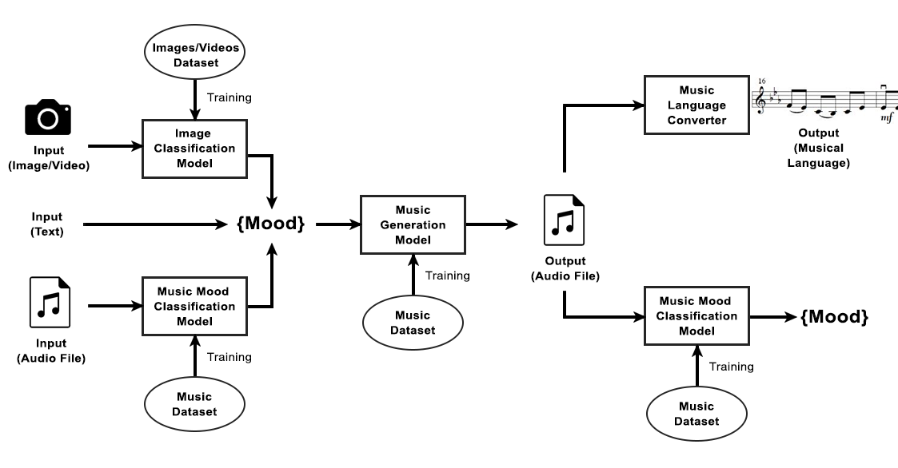
System Architecture

Slide 11
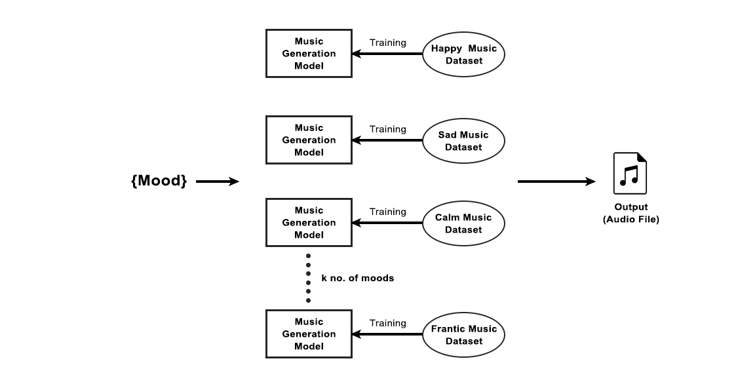
Methodology
Models pre-trained on specific moods

Slide 12
Dataset
Happy: 104 MIDI files
Sad: 194 MIDI files
Calm: 87 MIDI files
Duration: 53 seconds to 1 hour
Datasets:
Jazz ML Ready MIDI (Source: Kaggle)
Lakh Pianoroll Dataset (Source: GitHub)
Classical Music MIDI (Source: Kaggle)
MIDI Collection (Source: Reddit)
Websites:
Partners in Rhyme
Fredrik’s Music
MIDI World
8 Notes

Slide 13
Models Used
RNNs
LSTM
GANs
Transformers

Slide 14
Generated Music
LSTM (Sad)
GANs (Sad)

Slide 15
Transformers
These are Neural Networks that uses more encoders and decoders to achieve “attention”.
Musical notes are converted into text (Music21).
Text is tokenized: “xxbos xxpad n72 d2 n52 d16 n48 d16 n45 “.
Tokens to vectors.
Vectors are fed to Transformers.
Word-level encoding/decoding is done (attention).

Slide 16
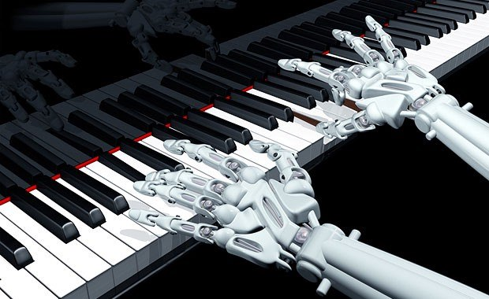
MEDLAI Demo

Slide 17
Final Output (Transformers)
Happy
Sad
Calm

Slide 18
Research Findings
RNNs:
Repeated notes, bad music quality,
LSTM
Better quality music, Repetitive music, couldn’t differentiate mood
GANs
Sound is pleasant than above two, not polyphonic, couldn’t differentiate mood for long time, not good with complex patterns
Transformers
“Selected Model”, takes relatively less time to train, produces good quality music, Polyphonic, maintains mood, differentiates mood

Slide 19
Results
Music is based on three moods: happy, sad, and calm.
Transformers proved better than rest of the models.
Transformers produced better quality music.
Transformers maintained the mood.
Polyphonic music is being generated.
Output in MIDI format and is playable.

Slide 20
Issues
Subjectivity issue

Slide 21
Work Breakdown

Slide 22
Images Sources
[1]https://wallpapercave.com/wp/ILXmRYl.jpg
[2]https://www.pinterest.com/janutt/sweet-emotions-mood-swings/
[3]https://www.igeeksblog.com/best-iphone-xr-wallpaper-apps/
[4]https://wallpaperplay.com/walls/full/3/f/d/327867.jpg
[5] Electrical and Computer Engineering Design Handbook/Music Mood Classification (Michael Nuzzolo)

Slide 23
References
[1] M. Nuzzolo, “Music Mood Classification,” Electrical and Computer Engineering Design Handbook, 2019. [Online]. Available: https://sites.tufts.edu/eeseniordesignhandbook/2015/music-mood-classification/.
[2] H. Henry Mao, T. Shin, G. W. Cottrell,” DeepJ: Style-Specific Music Generation”. [Online]. Available: https://cseweb.ucsd.edu/~gary/pubs/henry-deepj.pdf
[3] H. Jung, “Making Music: When Simple Probabilities Outperform Deep Learning”, Towards Data Science, 2019. [Online]. Available: https://towardsdatascience.com/making-music-when-simple-probabilities-outperform-deep-learning-75f4ee1b8e69
[4] D. Conklin, “Music Generation from Statistical Models”, 2019. [Online]. Available: https://pdfs.semanticscholar.org/69d4/e2740df45aed7dd587669c60cab2d99f83a2.pdf
[5] G. Peeters, A. Burthe, X. Rodet, “Toward Automatic Music Audio Summary Generation from Signal Analysis”, 2019. [Online]. Available: https://hal.archives-ouvertes.fr/hal-01161322/

Slide 24
References (Cont’d)
[6] L. Bigo, D. Conklin, “A viewpoint Approach to Symbolic Music Transformation”, Music, Mind, and Embodiment, 2019. [Online]. Available: https://books.google.com.pk/books?
[7] N. Jaques, S. Gu, R. E. Turner, D. Eck, “Generating Music by Fine-Tuning Recurrent Neural Networks with Reinforcement Learning”, 2019. [Online]. Available: https://storage.googleapis.com/pub-tools-public-publication-data/pdf/45871.pdf
[8] C. Huang, T. Cooijmans, A. Roberts, A. Courville, D. Eck, “Counterpoint by Convolution”, 2019. . [Online]. Available: https://ai.google/research/pubs/pub46746
[9] "Are there any classification systems that categorize music by mood?", Music: Practice & Theory Stack Exchange, 2019. [Online]. Available: https://music.stackexchange.com/questions/2927/are-there-any-classification-systems-that-categorize-music-by-mood
[10] H. Dong, W. Hsiao, L. Yang and Y. Yang, "MuseGAN: Multi-track Sequential Generative Adversarial Networks for Symbolic Music Generation and Accompaniment", Arxiv.org, 2017. [Online]. Available: https://arxiv.org/pdf/1709.06298
[Remaining in the report]

Slide 25
Thank You
Any Question?

